Slide 1

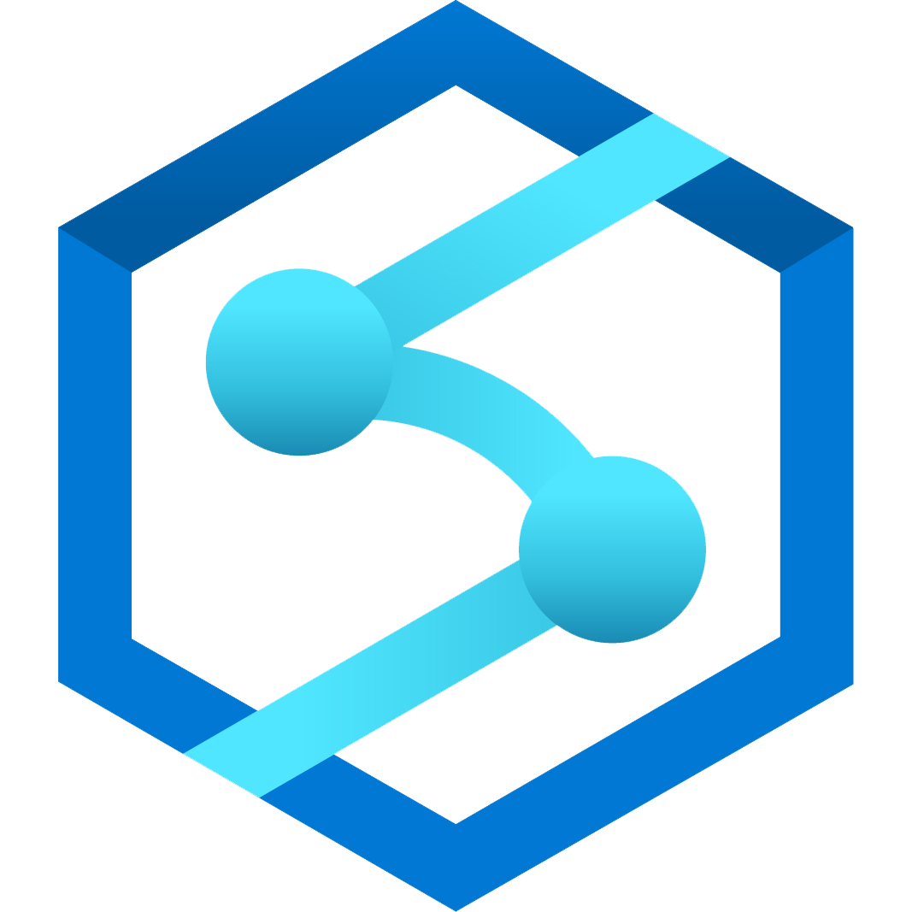

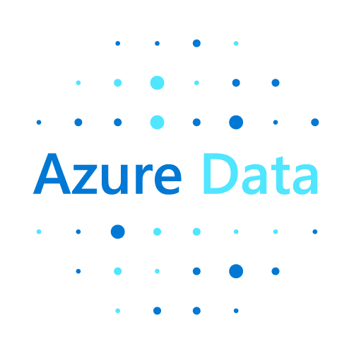
Azure Data Explorer Overview
Uri Barash
February 6th, 2023

Slide 2

Telemetry - A key data for Digital Transformation
50B
IoT
175ZB
Logs
Events
connected devices by 2030
Time Series
Click Stream
total amount of data by 2025
Connected Devices
SIEM
Smart Buildings
Security
Smart Factories
Historians
Notes:
Telemetry data is everywhere – we find it in IOT Sensors, application logs, click streams, user activity – it drives advances in the connected devices we find in our homes, smart buildings, smart factories, and in devices that consumers and businesses rely upon.
It is the fastest growing data segment as we race to instrument everything – Every activity by humans or machines can be used to optimize our products, user experience and how we operate our businesses ion general
Telemetry data is fueling digital transformation.
It’s generating terabytes and petabytes of data - every day.

Slide 3
Observational Data
Machine generated or machine recorded human interactions
Semi-structured: text, json, time series
Mass volume
What is it?
High velocity
Few large fact tables/streams
Notes:
Telemetry data is fueling digital transformation.
It is the digital imprint of every activity – Human or machines
The three Vs of big data:
Variety: Very often includes a lot of text and semi-structured data in addition to structures data
Volume: In petabytes
Velocity: Streaming in in high rates
Typically, few large activity tables with few small dimension table

Slide 4
Observational Analytics
Frequently changing business questions
Constantly changing schema
Near real time visibility required
Why is it challenging to analyze?
Analytics systems costs are often prohibitive
Looking for unpredictable phenomena
Notes:
What makes observational analytics special?
Velocity of the business environment is accelerating. We have the information flowing in and we are expected to use it to constantly improve how we operate
The data keeps changing, with new types and versions of devices and apps, changing vendors and business partners, and evolution of the information needs that drives deeper data collection.
A lot is encoded in text or json (Semi/unstructured)
ETLs can’t keep up with the constant change to structure it
Decisions need to be made in real time. Superbowl – Reference to slide – In game broadcast routing decisions to ensure viewing quality
Such vast amounts of data requires extreme efficiency to be able to perform it without emptying the pockets. Taboola – sample to 10-5% of the data to be able to continue monitoring SLA, loosing the ability to troubleshoot and conducting RCA. We helped them continue to use the data in lower cost and carbon footprint. https://aka.ms/adx.kustomers.Taboola – See slide
Unpredictable phenomena – Security, malfunctions, user and commerce trends, frauds, inventory attacks, Grab

Slide 5
Introducing Azure Data Explorer!
Any append-only stream of records
High volume
High velocity
High variance (structured, semi-structured, free-text)
Relational query model:
Filter, aggregate, join, calculated columns, …
Fully-managed
PaaS, Vanilla, Database
A big data analytics cloud platform optimized for interactive, ad-hoc queries
Purposely built
Rapid iterations to explore the data

Slide 6
Demo: High Velocity Monitoring

Slide 7
Kusto: Near real time analytics on observational data at petabyte scale
Large global footprint, offering storage in 54 data centers WW
Multi-geo capacities
119 local and international compliance standards
34 local and international industry certifications
Service tags
Private links
VNet
TLS 1.2 enforcement
BYOK encryption via Azure Key Vault
Double encryption at rest
Classify and protect data with MIP
Monitor and protect data with MCAS
Integrated security policy management, audit and compliance
Power BI tenant admin governance - permissions, settings, metrics
Analytics storage engine
Optimized
Native support
Low-latency
Human friendly query language
Now also in Synapse
for time stamped data: logs, time series, telemetry
for free text, structured and semi-structured data
Near real-time data analytics at scale
for ad-hoc analytics

Slide 8

Kusto by the numbers
150 PB
Data ingested
daily
2.8 Billion
Queries per day
12 Exabyte
Total Data Size
3M
VM Cores running
>450K
KQL Developers
A key to Microsoft's digital transformation journey

Slide 9
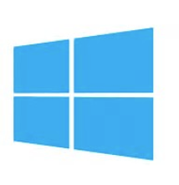
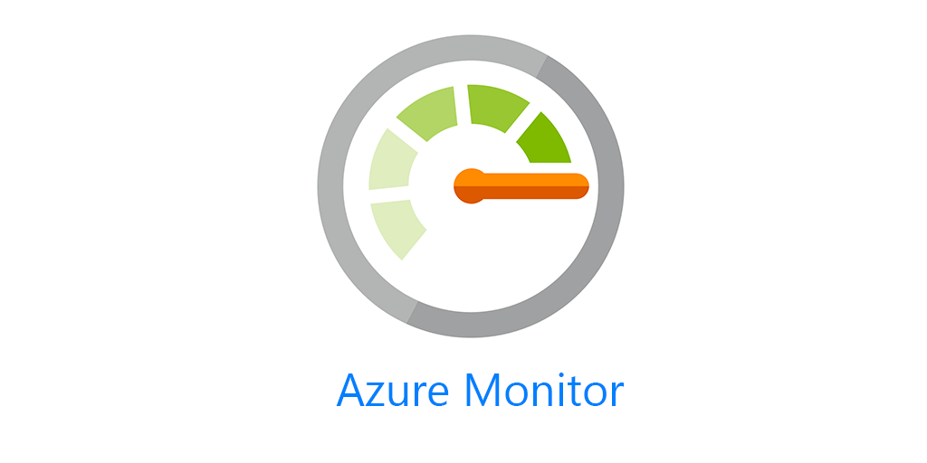







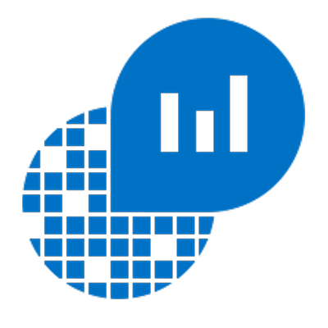




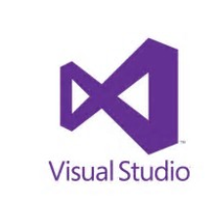
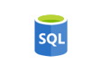


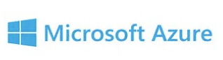
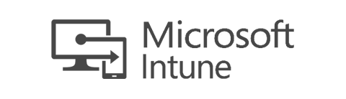
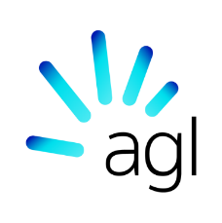




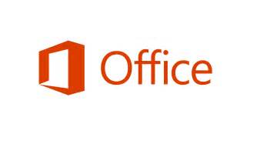


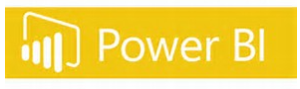

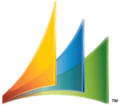
Proven Technology
2015: Production 2019: Generally available 2021: Formally in Synapse
Battle tested for Microsoft internal workload
The platform for analytical solutions (SaaS)
Available as PaaS
Azure Monitor
Security Products
IoT
#PoweredByADX
Notes:
Let me tell you about our journey with Azure Data Explorer.
To meet the growing demand of various Microsoft cloud services, Azure Data Explorer was home grown and launched back in 2015. Internally it’s called Kusto and used widely across Microsoft for telemetry analytics. It’s also the underline warm store for Azure Monitor, Application Insights, Azure Security Center, Time Series Insights, IoT Central, and more. All these services offers “a fit for purpose end to end solution”.
This is the same underline technology that we are offering to you as an Azure PaaS service.
© Microsoft Corporation

Slide 10
Demo: Operational Monitoring

Slide 11
Key usage patterns
Data platform for digital feedback loop
Enable data engineers, data scientists and product managers to gain ad hoc insights from their product's operations and activity telemetry
Data platform for interactive analytics products
Build interactive data exploration features based on ADX data platform
Notes:
the 2 main usage patterns are
Telemetry system to collect raw data from different sources, formats and structure like IoT event , logs and others
For exploration, run unpredicted queries , by developers, data scientist , operation and actually every one also program mangers
The second
Data base platform for solutions that require to store 0.5 a terra or more with requirements of high queries performance and data freshness

Slide 12
Start for free details
Zero friction onboarding
One per person
Virtual clusters technology
Specs (4 vCores, 8GB of memory, ~100GB of data)
Core functionality (Enterprise features are in the paid version)
One year trial, Microsoft may automatically renew

Slide 13
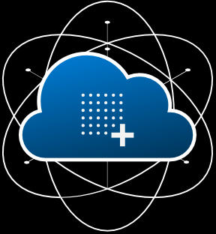
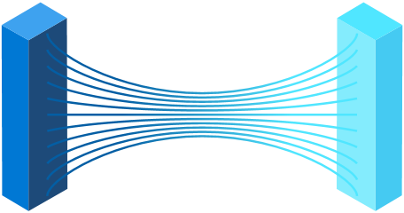
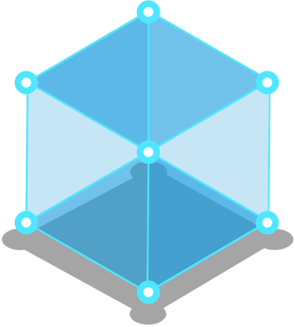


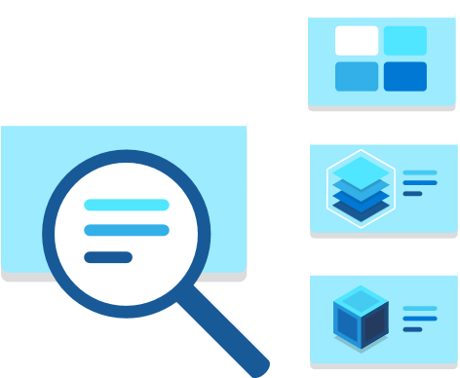
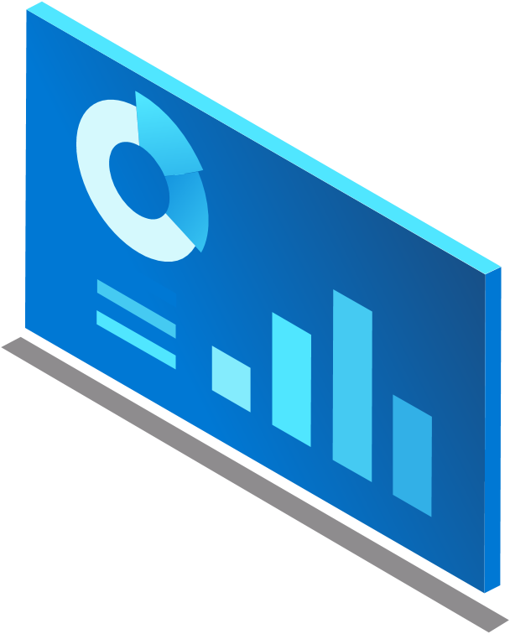
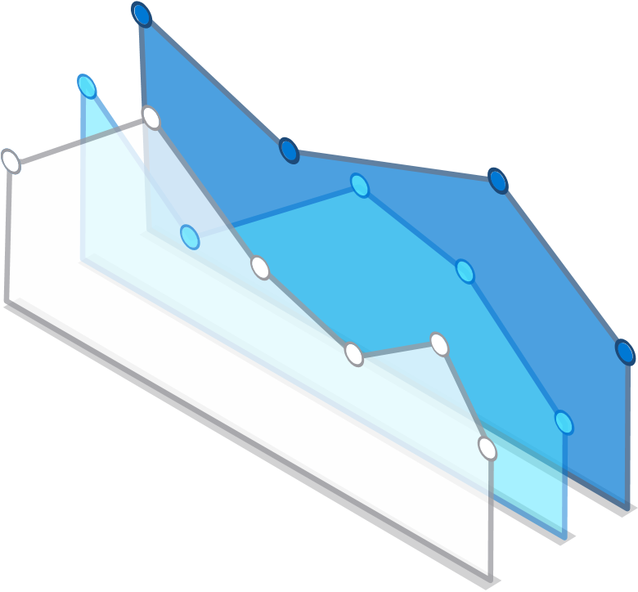

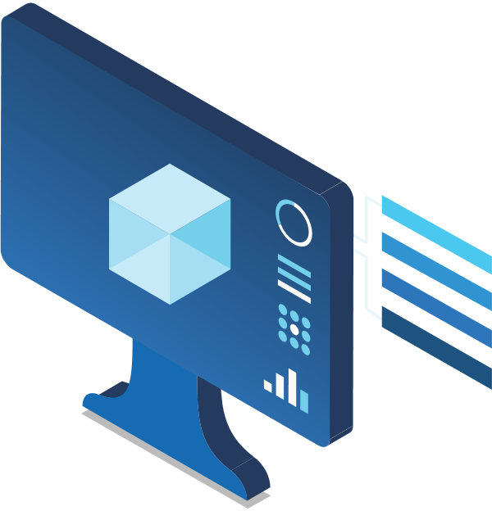
Azure Synapse data explorer
Distributed storage & query engine optimized for log & telemetry data
Notes:
Late last year we announced Azure Synapse data explorer, a distributed storage and query engine optimized for observational analytics log and telemetry data.
We are taking what used to be Azure’s best kept secret and make it a key element in our analytics story now and going forward. This is how we operate Microsoft, and this is how we are now powering the analytics needs with a constantly growing list of partners and enterprises
Extending Synapse Analytics capabilities to handle observational analytics over telemetry data
Integrated the Azure Data Explorer technology:
Connected Fully integrated and interoperable with the other Synapse components
Now also as part of the workspace deployment with managed VNet, same certification process in enterprise etc.
Just go new data explorer pool

Slide 14

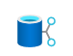






Run log & telemetry analytics seamlessly with Azure Synapse
Data Engineering - Data Warehousing - Data Science - Telemetry Analytics - Streaming Analytics - Intelligent Apps
Unified Experience
Azure Synapse Studio
On-prem
Integration
Management
Monitoring
Security
DevOps
Cloud data
Analytic runtimes
SQL
data explorer
Applications
Semantic Layer – Common Data Model
Streaming data
Data Warehouse
Data Lake
Event Brokers
Azure Synapse Link
Cosmos DB
Dataverse
Notes:
To complement our existing SQL and Apache Spark engines, the Azure Synapse data explorer engine is now part of Synapse ecosystem to enable you to run log and telemetry analytics seamlessly.

Slide 15
Azure Synapse Data Explorer – But which one?
ADX (Standalone)
ISV workloads
Azure Compute and Storage Reserved Instances
SKU selection needed
In place sharing (Data share)
Cost +
DX Pool in a workspace
If you have a workspace
Managed VNet
Synapse already certified by the customer
Still in preview
vCore + Storage pricing
Work in progress to make it not matter:
P3 inclusion
Move databases
Differences between Azure Data Explorer and Azure Synapse Data Explorer (Preview) - Microsoft Docs

Slide 16
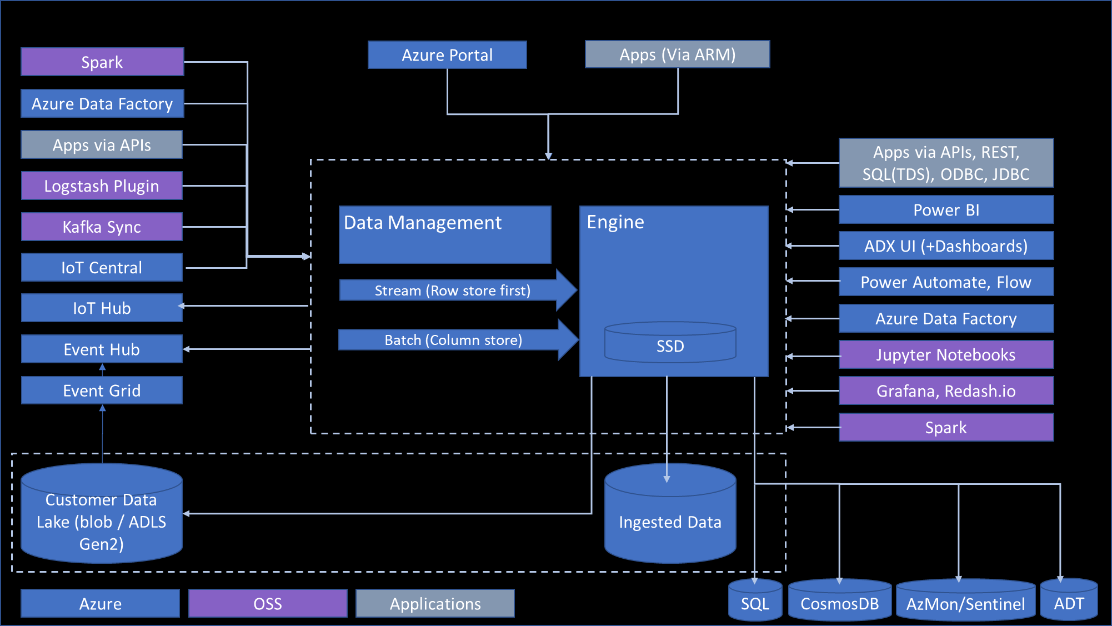
Architecture
Comprehensive Strength
Analytics Query language
Simple and powerful
High performance over large data sets
Granular resource utilization Control
Metrics and time-series data
Text search and text analytics
Multi-dimensional/relational analysis
Publicly available
Data Exploration
Scale out in hardware
Scale out across geos
Rich relational query language
Full text Search
ML Extensibility
Data Ingestion and Management
Low Latency ingestion
Schema management
Compression and indexing
Retention
Hot/cold resource allocation
Cross geo queries
Notes:
Let’s look at Azure Data Explorer architecture.
It’s a PaaS service and you don’t have to maintain any infrastructure. The cluster includes two types of compute nodes: Data Management – responsible for ingestion and background jobs, it provides managed ingestion pipeline from Event Hub, IoT Hub, and Storage. Engine nodes are responsible for caching the data on local SSD’s and running distributed queries. The compute and storage are decoupled, and it can grow independently and is flexible.
On the left side, there is a list of supported data sources and on the right-hand side different integrations and tools you can use to access the data.
ADX also has external table support for exporting data to storage and querying that data.

Slide 17
Demo: Cost control

Slide 18

Cloud Scale Analytics - Common Workload Patterns
Modern data warehousing
Machine Learning
Real-time analytics
"We want to analyze data coming from multiple sources and in varied formats"
"We want to leverage the analytics platform for advanced fraud detection"
“We’re trying to get insights from our devices in real-time”
Synapse
Synapse
Synapse
Notes:
3 patterns
Modern data warehouse for curated data models, etl to deal with unstructured
This week - Synapse – Rebrand DW, new Spark and integration
Today we will focus on Real time analytics

Slide 19

Modern Data Warehouse
Ingest & Prep
Model & Serve
Visualize
Logs (unstructured)
Azure Data Factory
Code-free data ingestion from 85+ data integration connectors
Dedicated SQL Pool (Data Warehouse)
Power BI
Media (unstructured)
Synapse Pipelines and Spark
Up to 14x faster and costs 94% less than other cloud providers
Leader in the Magic Quadrant for Business Intelligence and Analytics Platforms*
Files (unstructured)
Fully managed
High performance
Business/ custom apps (structured)
Store
Azure Data Lake Storage
High performance data lake available in all 54 Azure regions

Slide 20



Azure powered pattern for real-time analytics
Ingest
Analyze
Apps and analytics
Streaming Data
Continuous/ Streaming real-time analytics
Logs, Files, Media
IoT Hub
Alerts and actions
Real-time apps
Real-time dashboards
On-demand dashboards
Data warehousing
Batch and ML training
Storage / archival
Azure Stream Analytics
Customer sentiment data
On-demand/ Interactive
real-time analytics
Weather data
Event Hubs
Azure Data Explorer
Business Applications
Notes:
© Microsoft Corporation
Real-time analytics is the discipline that applies logic and mathematics to data to provide insights for making better decisions quickly. For some use cases, real time simply means the analytics is completed within a few seconds or minutes after the arrival of new data. On-demand real-time analytics waits for users or systems to request a query and then delivers the analytic results. Continuous real-time analytics is more proactive and alerts users or triggers responses as events happen.

Slide 21
Run log & telemetry analytics seamlessly with Azure Synapse Analytics
Observational Analytics
Interactive
Data warehousing
Kusto
SQL
Raw
Data
Well Curated
Pre-processed
Spark
Referential
Integrity
Transactions
Batch, long running, heavy duty model training
Machine learning
ETL

Slide 22
Analytical Power and Innovation Velocity – Past year
Analytical Power
Engine v3
Sequence Analytics (Scan)
Geo Spatial
Data Management
Materialized views
Partitioning
Parquet ingestion and query
Soft delete
Hot cache windows
Operations
Private endpoints,
Predictive Auto scale
Visualization
Dashboard Import/export
Dashboard Cross filter
Better Kibana support
Dev Experience
Python and JavaScript code generation for ingestion flows
Notes:
Cross filter: ADX dashboards November 2021 updates (microsoft.com)
Parquet improvements:
Direct translation of parquet to CSV
Query of parquet in the data lake is much better as we added predicates pushdown
Export to parquet has a new mode (useNativeParquetWriter) that is still in testing. This mode exports parquet using native writer (as opposed to .Net writer).

Slide 23
Analytical Power and Innovation Velocity – Ignite 22
Data Sources
Cosmos DB Synapse Link to A[S]DX
AWS S3 native ingestion
Azure Stream Analytics connector GA
Open Telemetry connector
Telegraf output adds streaming
Protobuf
Management
No / minimal downtime SKU change
Table Level Sharing support via Azure Data Share (GA)
Aliasing follower databases (GA)
Leader follower discoverability
Performance
Lsv3/Lasv3 SKU availability (GA)
Improved performance of export + ingestion to parquet (Preview)
Improved performance for SQL requests (Preview)
Hyper-V support for sandboxes
Query Power
Scan operator (Sequence analytics) GA
Parse-kv operator (GA)
New Python image for the inline python() plugin (Preview)
Visualization
ADX Dashboards GA
Plotly support in ADX Dashboards (Preview)
Dashboards base query (GA)
Kusto Trender (GA) – AKA TSI UX
Partner and Dev Experience
Partner Program
Kusto Docker Emulator for CICD
POC Playbook
Notes:
Cross filter: ADX dashboards November 2021 updates (microsoft.com)
Parquet improvements:
Direct translation of parquet to CSV
Query of parquet in the data lake is much better as we added predicates pushdown
Export to parquet has a new mode (useNativeParquetWriter) that is still in testing. This mode exports parquet using native writer (as opposed to .Net writer).

Slide 24
Analytical Power and Innovation Velocity – Coming Soon
Data Formats and Sources
Delta ingestion, query and export
Complete: Open Telemetry output
Complete: Home Assistant
Query Power
Time aware data contextualization graph semantics
Management
Move all databases across pools and clusters
Enterprise Promises
Confidential Compute
Machine Learning
Multivariate prediction
Virtual environments
Partner and Dev Experience
Find a partner
Notes:
Cross filter: ADX dashboards November 2021 updates (microsoft.com)
Parquet improvements:
Direct translation of parquet to CSV
Query of parquet in the data lake is much better as we added predicates pushdown
Export to parquet has a new mode (useNativeParquetWriter) that is still in testing. This mode exports parquet using native writer (as opposed to .Net writer).

Slide 25
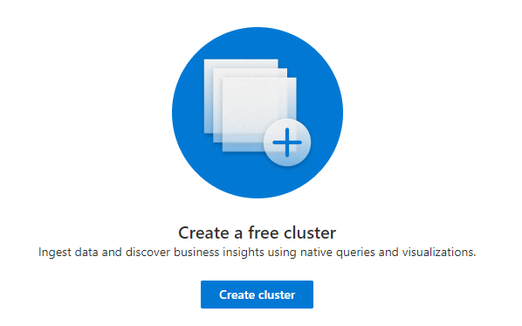
Remove barriers for entry

Slide 26
Demo: Start free with Azure Data Explorer

Slide 27

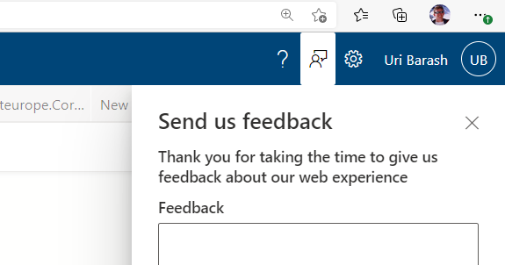
Start for free with Kusto
https://aka.ms/adx.free
Use web explorer feedback to report issues

Slide 28

Customers are saying about Azure Data Explorer
“In terms of usability it is beyond compare any other database query language we have used so far.”
“The solution was so simple that we were up and running in a week, ingesting and analyzing 17 TB of data per day.”
Ariel Pisetzky
Vice President of IT
Emilian Ertel Senior Key Expert

Slide 29


With ingestion speeds of 600,000 records per table per second―for a total of nearly 37 billion records per table, across dozens of tables―Azure Data Explorer has also drastically improved Taboola’s data processing speeds. It enabled high throughput data ingestion from the Microsoft Azure Content Delivery Network (CDN) provider with near real-time latency. “It was hours and minutes compared to seconds, now. But beyond that, it was also a case of working versus not working,” recalls Pisetzky
https://customers.microsoft.com/en-us/story/837528-taboola-entertainment-azure-en-united-states
Notes:
Checkpoint is a leading provider of cyber security solutions to governments and corporate enterprises globally. They are leveraging Azure Data Explorer today to help protect their customers from 5th generation cyber-attacks by offering SaaS services for analytics.

Slide 30


Connected Trucks Connected Factories
Ingesting 9 trillion rows and 900+ terabytes of data!!!
Notes:
Daimler Trucks North America is an automotive industry manufacturer of commercial vehicles, they are using Azure Data Explore to power their digital transformation journey by building solutions around Connected Trucks and Connected Factories. Ingesting 9 trillion rows and 900+ terabytes of data!!!

Slide 31


“the query language that KQL is very adapted to what we're trying to do … blazing fast, magically fast. I think the engineers throw some pixie dust at it to make it run faster”
Sherif Zaroubi, Partner/CEO, Axceta
Leveraging Azure Data Explorer to power it smart grid
Notes:
Hilo is a Hydro Québec subsidiary that offers a complete smart energy service for your home and business. Hilo is leveraging Azure Data Explorer to power its smart grid service and help its consumers save energy and help the local utility company manage electricity demand.

Slide 32
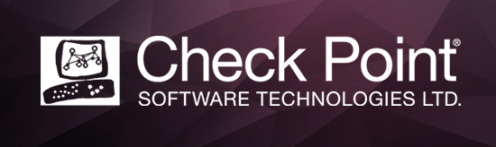
Leveraging Azure Data Explorer to help protect their customers from 5th gen cyber-attacks
Notes:
Checkpoint is a leading provider of cyber security solutions to governments and corporate enterprises globally. They are leveraging Azure Data Explorer today to help protect their customers from 5th generation cyber-attacks by offering SaaS services for analytics.

Slide 33


Leveraging Azure Data Explorer for powering Energy and Building Solutions
Notes:
BOSCH is leveraging Azure Data Explorer for powering their Energy and Building Solutions that they are offering to their customers.

Slide 34


“We're ingesting 1 TB per day now. Previously, we could only ingest around 80–100 GB per day. So, we both saved money and increased our ingestion rate.”
Gleb Lesnikov: Cloud Architect
Dodo Pizza
Microsoft Customer Story-Data-driven Dodo Pizza raises performance with Azure Data Explorer
Notes:
Microsoft Customer Story-Data-driven Dodo Pizza raises performance with Azure Data Explorer

Slide 35


“We considered a number of different options, including those from Microsoft, and ended up settling on Azure Data Explorer. Firstly, it satisfied our criterion of being serverless, so we didn’t need to manage it. Secondly, it acts like a column store and aggregates data quickly.”
Andrew Naish: Platform Delivery Lead
Integrated Energy Technology, AGL
By connecting solar batteries located across homes, AGL’s innovative virtual power plant (VPP) forms the heart of an innovative energy partnership between retailers and consumers that is spreading through Australia
Notes:
Microsoft Customer Story-Growing an innovative energy partnership across Australia

Slide 36


MFTBC’s Truckonnect uses Azure Data Explorer to improve the customer experience and lower costs
“Azure Data Explorer has enabled us to provide a better experience and the best possible product for our customers.”
Peter Veigele: Head of Connectivity & Digital Services
MFTBC
Notes:
Microsoft Customer Story-MFTBC’s Truckonnect uses Azure Data Explorer to improve the customer experience and lower costs

Slide 37


Bühler Group enables intelligent manufacturing insights for a safer, greener tomorrow
With the help of the Bühler Insights platform and Microsoft Azure Data Explorer, Bühler’s customers are finding new ways to optimize their operations, reducing waste and energy usage, while increasing output.
Notes:
Microsoft Customer Story-Bühler Group enables intelligent manufacturing insights for a safer, greener tomorrow

Slide 38
Partner Program
Free POC for ADX/SDX resources
No charges on the Kusto resources
Well defined POC scope and goals
https://aka.ms/adx.freepoc.request
Partner ECIF for AMD powered deployments
AAAP ECIF offer & blog post
Training, upskilling and technical backup during projects
Partner discovery experiences
Based on geo, reference projects and more
| join us: https://aka.ms/adx.partnersinfo

Slide 39
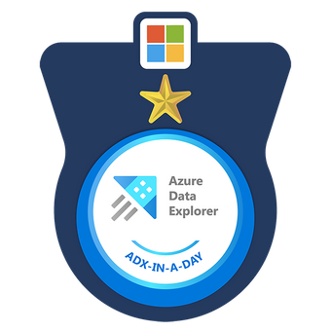
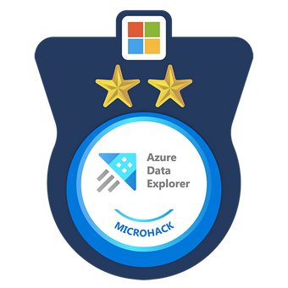

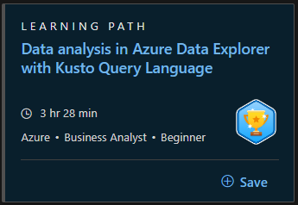
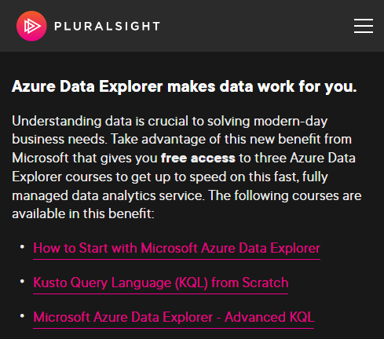
ADX Learning Programs
ADX-in-a-Day
ADX Microhack
Kusto Detective Agency
MS Learn module on Azure Data Explorer
Pluralsight Course on Azure Data Explorer
MS FTE Only: Request ADX Learning Sessions (ADX-in-a-Day or ADX Microhack)

Slide 40
Online Content Links
Product
Product Page: https://aka.ms/adx.pp
Docs: https://aka.ms/adx.docs
Cost Estimator: https://aka.ms/adx.cost (Excel)
Whitepaper: https://aka.ms/adx.techwhitepaper
101 blog: https://aka.ms/adx.blog.101
Reference Architectures - https://aka.ms/adx.architectures
Social and Community
Twitter: @AzDataExplorer
Stack overflow: https://aka.ms/adx.sof
Tech Community Blog: https://aka.ms/adx.blog
Tech Community Forum: http://aka.ms/adx.techcommunity
YouTube Channel: https://aka.ms/adx.youtube
Free Online Courses
MS Learn: https://aka.ms/learn.kql, https://aka.ms/learn.adx
Pluralsight: https://aka.ms/adx.pluralsight: KQL from Scratch, Azure data exploring, How to start with ADX (blog), Advanced KQL (blog)
Hands on
Start free: https://aka.ms/kustofree
Lab: https://aka.ms/adx.lab
Help and samples - http://aka.ms/adx.try

Slide 41
Thanks!
Uri Barash, urib@microsoft.com

Slide 42
Common use cases across verticals
Retail
Financial
Oil/Gas & Energy
Security
Web Analytics, IoT Analytics
Audit Logs
Industrial IoT, Historian, Time Series, Grid analytics
Security Analytics, Threat Detection, SIEM
Healthcare
Advertising
Media Entertainment
Automotive
IoT device
Analytics
Personalized offers, campaign management
Content Delivery Network analytics, Viewer experience analytics, Live Event Analytics
Manufacturing, Connected cars, Fleet management
Central Observability (Logs, Traces, Metrics) and Time Series
Notes:
There are various Log and Time Series across the industries to:
Consolidate and correlate logs and events data across on-prem, cloud, 3rd party
Replace legacy log search solutions
Accelerate your AI Ops journey (pattern recognition, anomaly detection, forecasting, etc.)
Building IoT Analytics

Slide 43
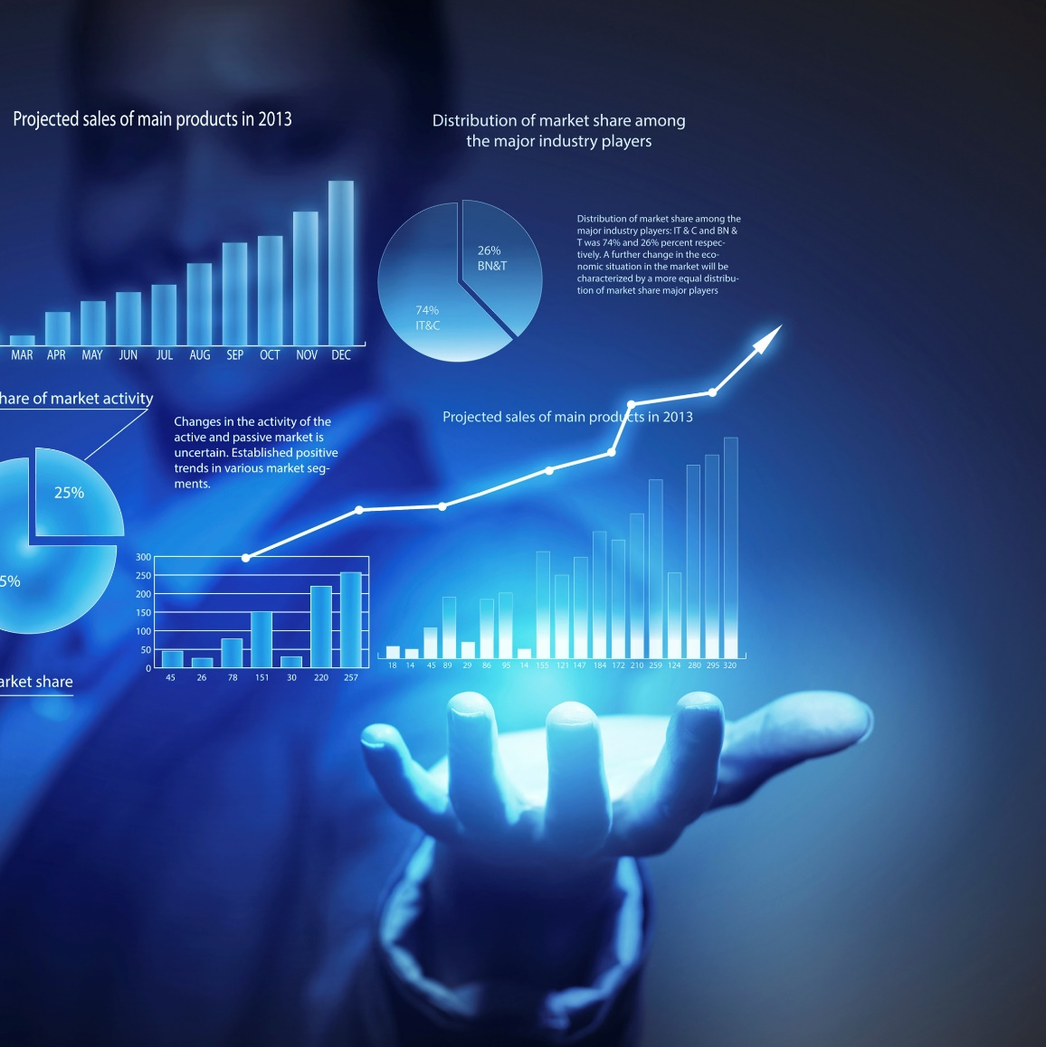
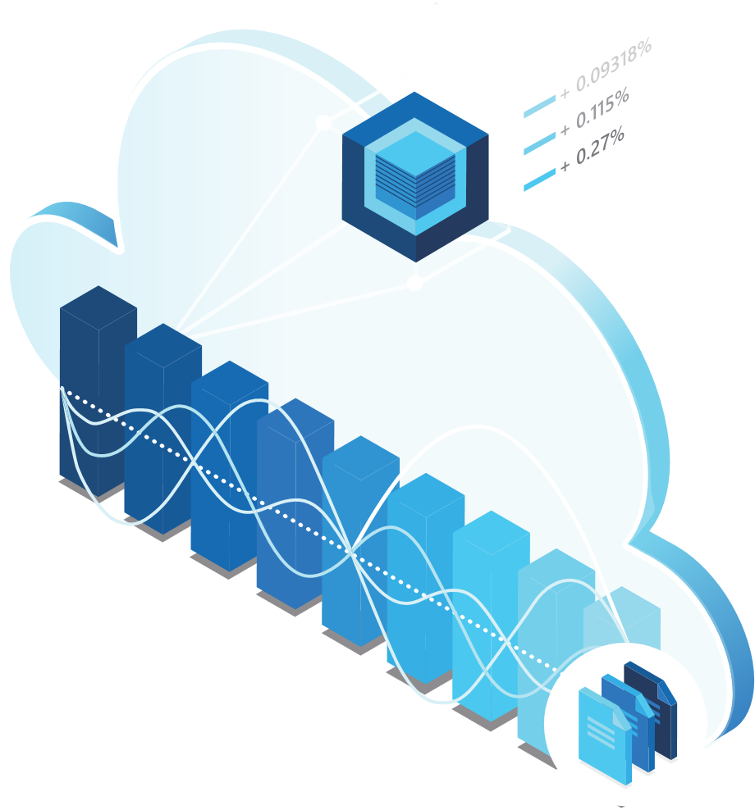
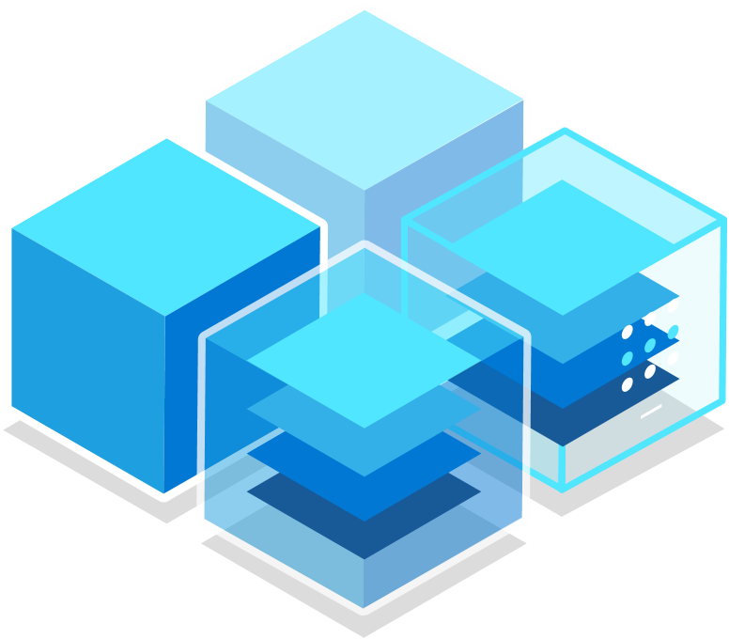
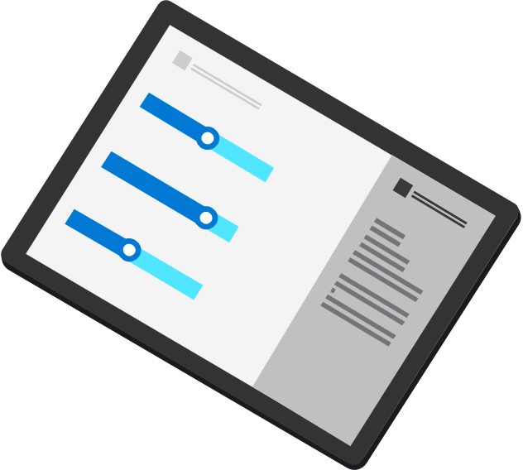
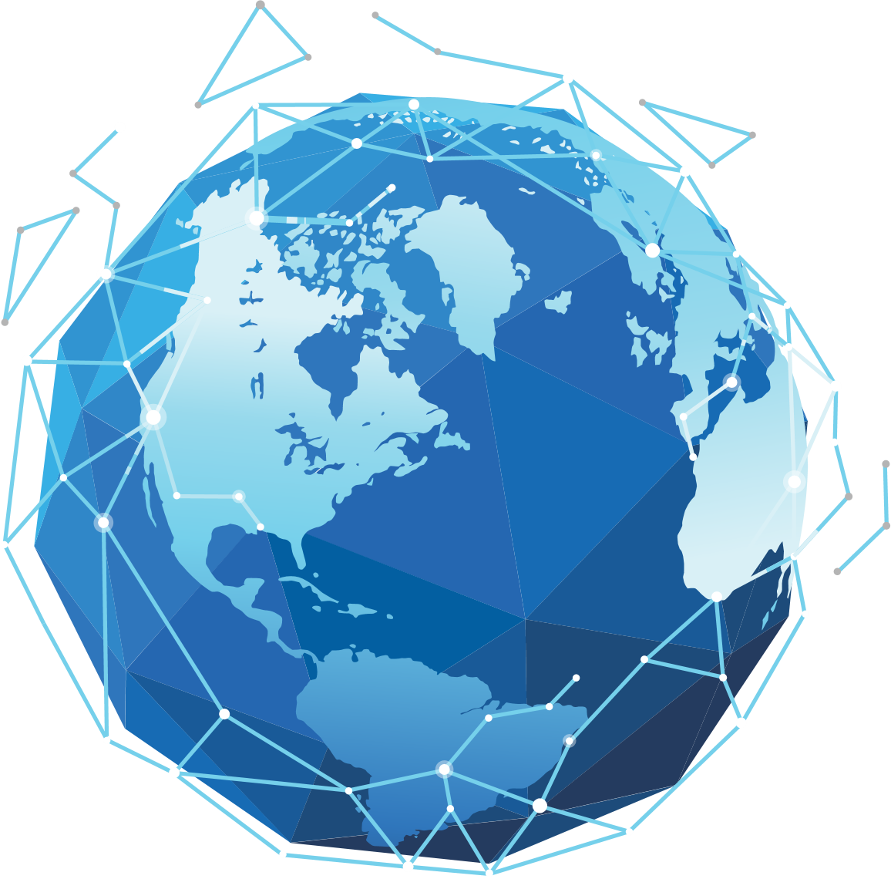
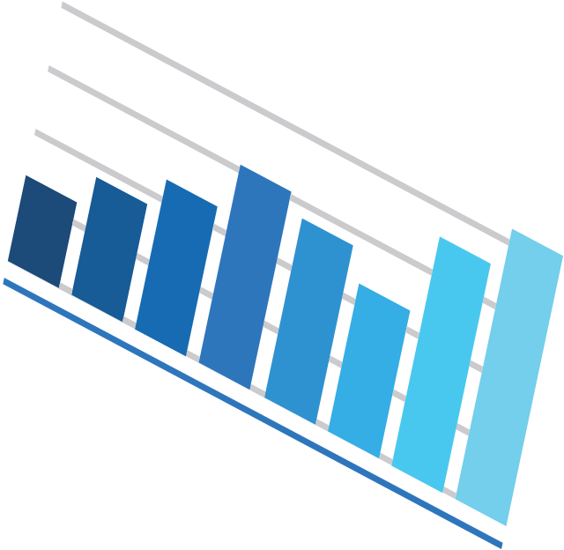
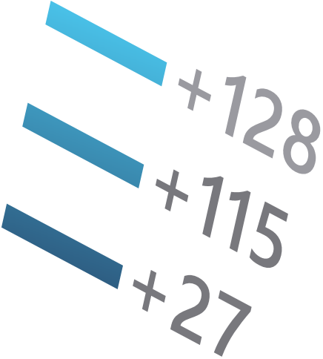

Scenarios
Building near real-time Big Data analytics on custom event/logs data
Security log analytics
IoT analytics solutions
ISV workloads
Centralized near real-time observability solutions from all telemetry sources
Notes:
Building near-real-time Big Data analytics on custom event\logs data
For Examples,
A telco company ingesting TBs of data every day on their subscriber call data, network data, etc. and analyzing it to improve subscriber experience.
A major Oil & Gas company ingesting millions of credit transaction logs to analyze the health of payment systems on gas stations.
A large media company ingesting TBs of CDN data to analyzing and improve the live streaming experience for their subscribers.
A large logistics company ingesting millions of shipment tracking records and analyzing it.
Build centralized near-real-time observability solutions for all telemetry sources
You can centralize your log data and building solutions to meet your scale
Security log analytics
Companies org/collect logs. User it for observability (how infra/software is working); logs used to analyze security of environment. Trying to find phishing, hacker, attacks, looking at network logs. Looking at IP addresses—traffic coming from it.
Customers migrating from Splunk SIEM to Sentinel and using Data Explorer to complement long term analytics
ISVs building security log analytics solutions
IoT analytics solutions
Customers and ISVs building IoT\Time Series solutions
Building cloud-based historians in combination of Data Explorer, Data Lake, Spark
Tons of use cases in connected devices, manufacturing, energy, oil & gas, automotive sector
Note: All Azure Data Explorer scenarios apply here, you can check the customer stories here: http://aka.ms/adx.stories

Slide 44
















Azure Data Explorer Customer Stories (Public)
https://aka.ms/adx.kustomers
Notes:
Here are “happy” customers they are using Azure Data Explorer today.
More customer stories at https://aka.ms/adx.stories

Slide 45
Integration Patterns

Slide 46

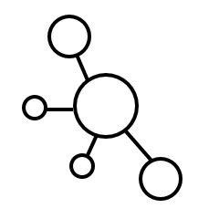
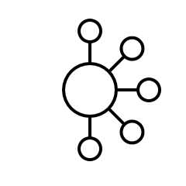
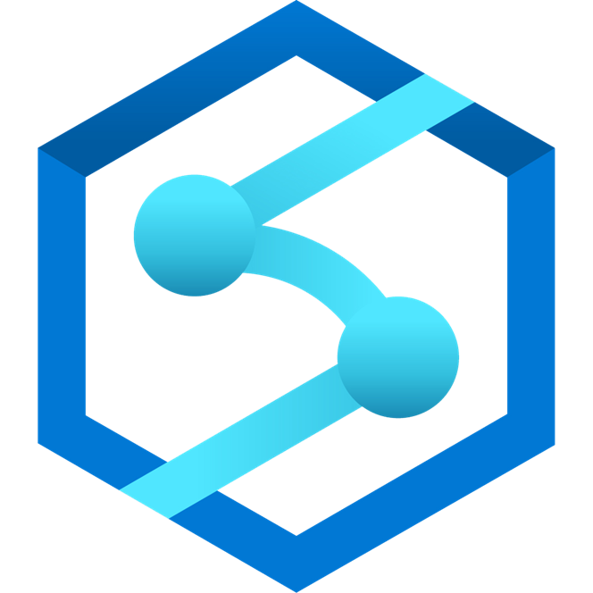
Integration: Streaming Ingestion
Land your data in ADX and then export to the data lake
Moving window of data (days to months)
Real-time, cached and indexed data for faster interactive query over billions of records
Logs (unstructured)
Streaming
Event Hub
Azure Data Explorer
Export to Data Lake
Media (unstructured)
Azure Data Lake Storage
IoT Hub
Files (unstructured)
Kafka
Business/custom apps
(structured)
Azure Data Factory
Azure Synapse Analytics
Azure Analysis Services
Power BI
Notes:
There are two typical patterns:
Streaming ingestion for low latency insights where the data directly lands into ADX, where its cached and indexed for faster query performance and optionally exported out to Azure Data Lake in parquet format ready for batch processing and integration with other Big Data and ML services.

Slide 47
Integration: Batch Ingestion
Ingest data from Data Lake or other sources in batch mode
Moving window of data (days to months)
Real-time, cached and indexed data for faster interactive query over billions of records
Logs (unstructured)
Event Hub
Azure Data Explorer
Ingest from Data Lake
Media (unstructured)
Azure Data Lake Storage
IoT Hub
Files (unstructured)
Kafka
Business/custom apps
(structured)
Azure Data Factory
Azure Synapse Analytics
Azure Analysis Services
Power BI
Notes:
You can also ingest data in batches to cache and index the data in ADX.

Slide 48
How it works

Slide 49

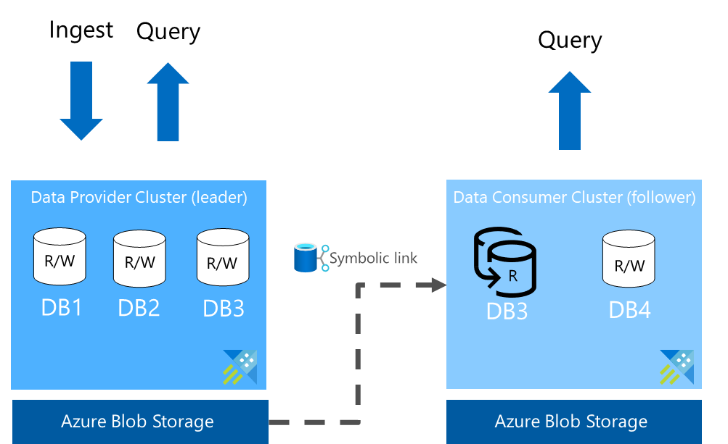
Azure Data Share - Data Sharing
Share data within the company
Load balancing
Ring fencing
Data-as-a-service
Chargeback
Share data with partners
Data sharing in near-real-time
In-Place Data Sharing
No data pipeline to maintain
Near-real-time updates
Share data with customers
Data sharing in near-real-time
Extend your business model
Notes:
Data Share integration enables sharing data:
Within the company
Across companies – tenants
Optimize my business
Typical Use Cases
Data providers can use this integration to share their data with their customers in a simple and secure way. Example, a weather forecast provider can share their data in near-real-time with their customer without having them to maintain the data pipeline. As the data is updated on the leader cluster, the change will appear on the follower cluster in few seconds or minutes depending the data volume and metadata.
Organizations can share their data with partners for collaboration and data exchange. For example, a retail company sharing the data with their suppliers.
Share data within the company or provide data-as-a-service. Many organizations would like to share the data within the company and have individual teams accountable for their usage and cost. With Azure Data Explorer, every team could have their cluster with their choice of configuration and sharing the same data from one leader cluster.

Slide 50
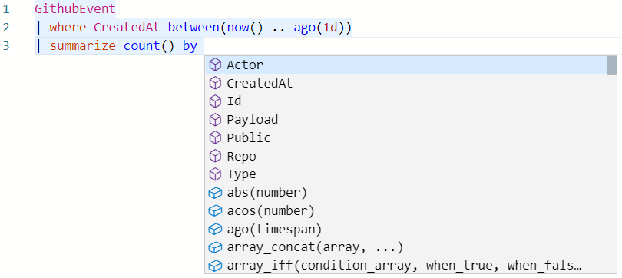
Intuitive querying
Simple and powerful
Rich rational query language (filter, aggregate, join, calculated columns, and more)
Built-in full-text search, time series, user analytics, geospatial, and machine learning operators
Out-of-the box visualization
Easy-to-use syntax + Microsoft IntelliSense
Highly recognizable hierarchical schema entities
Extensible
In-line Python and R
T-SQL

Slide 51
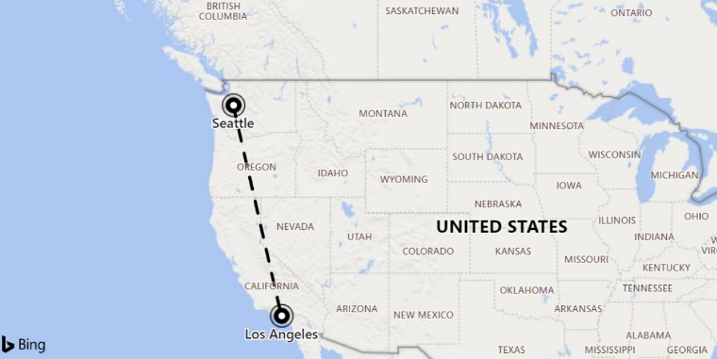
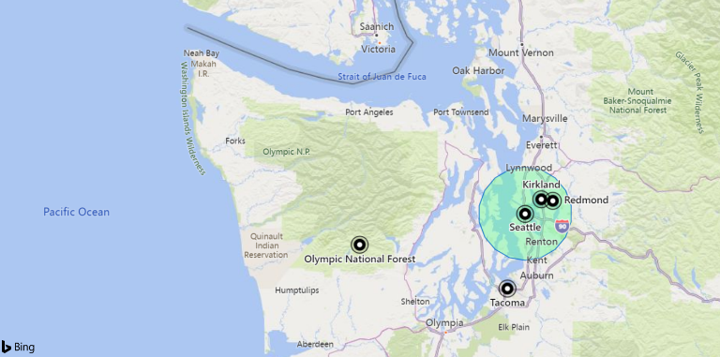
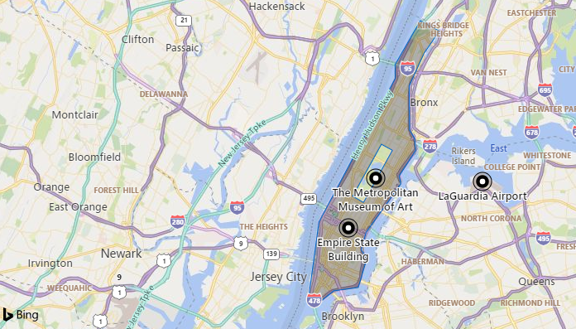
Geospatial query
Support for geospatial clustering
Transformation from coordinates to geospatial clusters and back
Support for Geohash, S2 and H3 cells
Distance
Calculate the distance between two points or a point and a line / polygon
Contains
Check whether a point is in a given circle or polygon
Advanced features
Densification to control shape edges, geodesics or straight lines
H3-Rings, parents & children
Geospatial coordinates are interpreted as represented per the WGS-84 reference system
Notes:
Geohash
https://docs.microsoft.com/en-us/azure/kusto/query/geo-point-to-geohash-function
https://docs.microsoft.com/en-us/azure/kusto/query/geo-geohash-to-central-point-function
Points in circle
https://docs.microsoft.com/en-us/azure/kusto/query/geo-point-in-circle-function
Distance
https://docs.microsoft.com/en-us/azure/kusto/query/geo-distance-2points-function

Slide 52
Advanced Analytics – Built-in & Extendible
Out of the box
Auto Clustering for Diagnosis and RCA
Anomaly Detection
Regression
Forecasting
Time Series Analysis library
Distributed Custom Code Execution
Distributed Python and R execution
Custom code is embedded in the KQL query
Spark Integration
Native Spark connector for heavy duty model training
Operationalize model into ADX for scoring
Tools
Jupyter Integration with KQL Magic
Python, Java SDKs

Slide 53


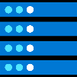



Pricing – Flexible Cost
Reserved resources cost model
Dedicated capacity
Reserved instance pricing available
Advantages of this model
Freely explore your data - not bound by cost per query
Predictable cost
Decoupled storage and compute
Easy to switch between SKUs after provisioning
Ability to Start/Stop the compute
Four main components
Compute Hourly billing
Storage & Transactions Used for persistent store, compressed data (typical 6x compression)
Network
Markup/IP Cost of using the PaaS Service – hourly billing based on the compute usage
http://aka.ms/adx.cost
Wide range of options
CPU optimized and Storage optimized SKUs Dev/Test SKU under $200/month PROD SKUs starting around $600/month

Slide 54

Enterprise Ready – Mission Critical
Azure Active Directory Integration
Availability Zones
Role based authorization
Auto Scale-Up/In
Network Perimeter Security
Globally available
Encryption with customer managed keys/”BYOK”
CI/CD Integration
Build Azure Policy Support
Automated provisioning
Bring Your Own Keys
Monitoring
Notes:
Azure Data Explorer is enterprise ready will all the key capabilities you need get to production.

Slide 55

ADX - The platform for Analytical SaaS
Customer Need | Azure Monitor | Azure Security * | Industrial IoT - Time Series Insights - | Xbox Playfab | MCVP
A fit for purpose end to end solution. | Lead with Azure Monitor Log Analytics and Application insights when the customer needs an E2E solution for IT infrastructure, services and applications monitoring and analytics. App and infra monitoring models and knowledge OOB Full multitenant monitoring experience with alert, dashboards Smart analytics for monitoring Solution framework for specific more knowledge domains Powerful analytics capabilities of KQL over time series and telemetry data | Lead with the Microsoft security solutions like Windows Defender Advanced Threat protection, Azure Security Center and azure Security Insights when the customer needs a security solution Security knowledge applied out of the box Automatic remediation, protection Powerful analytics capabilities of KQL over time series and telemetry data | Lead with TSI when the customer needs an end-end-end solution for Industrial IoT analytics that offers: IoT-optimized, turnkey, PAYG, serverless platform Rich semantic modeling for contextualization of time series data Asset-based analytics user experience for discovery, trending, anomaly detection and operational intelligence | Lead with Playfab when the customer needs full platform for game development including game analytics and data exchange | Lead with MCVP for connected cars E2E fit for purpose solution and platform
A flexible platform to build custom analytical solutions. | Recommend ADX when the customer is building their own analytics solution or platform and needs: Full control of data sources, data schema and data management Powerful analytics capabilities of KQL over time series and telemetry data Reserved resources cost model

Slide 56
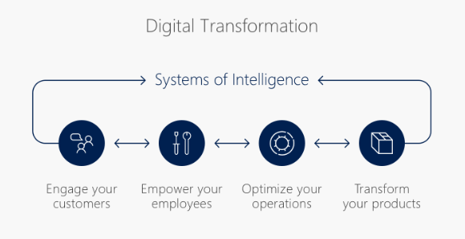

The Digital Transformation
“
digital feedback loops that help you better engage with your customers, empower your employees, optimize your operations, and reinvent products and business models
“
S. Nadella
https://www.linkedin.com/pulse/digital-transformation-satya-nadella/

Slide 57
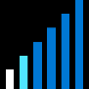


Big Data in Modern Business Environment
Free text data
Append Only
Click streams
Wikis, Blogs
Sensors/RFID/ Devices
Social Sentiment
Audio/Video
BigData
New decisions daily
Petabytes
Log files
Spatial & GPS coordinates
Data market feeds
eGov feeds
Weather
Text/image
Advertising
Mobile
Collaboration
eCommerce
Terabytes
Web 2.0
ERP/CRM
Web logs
Digital Marketing
Search Marketing
Recommendations
More decision makers
Gigabytes
Payables
Payroll
Inventory
Contacts
Deal Tracking
Sales Pipeline
Megabytes
Data Complexity: Velocity, Variety

Slide 58
Multi-temperature data processing paths
Hot
seconds freshness, days retention
pre-defined standing queries
Warm
minutes freshness, months retention
Cold
hours freshness, years retention
data viewing
in-mem aggregated data
raw data
ad-hoc queries
data exploration
raw data
programmatic batch processing
data manipulation
split-seconds query performance
seconds-minutes query perf
minutes-hours query perf
in-mem cube
stream analytics
…
column store
Indexing
…
distributed file system
map reduce
…

Slide 59
Introducing Azure Data Explorer!
Any append-only stream of records
High volume
High velocity
High variance (structured, semi-structured, free-text)
Relational query model:
Filter, aggregate, join, calculated columns, …
Fully-managed
PaaS, Vanilla, Database
A big data analytics cloud platform optimized for interactive, ad-hoc queries
Purposely built
Rapid iterations to explore the data

Slide 60
Key pillars of Azure Data Explorer
INSTANT BIG DATA INSIGHTS
FULLY MANAGED PLATFORM
DEMOCRATIZING DATA ANALYTICS
PROVEN TECHNOLOGY TO SCALE FROM GBs PETABYTE
Notes:
Instant Big Data Insights ---Azure Data Explorer is a big data platform supporting near real time insights over data in petabyte scale
Fully Managed Platform - ADX is a fully managed platform for big data analytics. Embed Azure Data Explorer in SaaS applications to build multi-tenant or single tenant SaaS analytics solution for Time Series, Logs, Events, Transactions, and security data. No infrastructure management, no maintenance.
Democratizing Data Analytics - Azure Data Explorer democratizes self-service, big data analytics, with the intuitive Kusto Query Language (KQL) that provides the expressiveness and power of SQL with the simplicity of Excel
Proven Technology at Scale Petabyte - Azure Data Explorer is a distributed system with compute and storage that can scale independently, enabling analytics on gigabytes to petabytes of data.

